Slide 1
Breeding for Superior Beef Meat eating Quality
Michelle Judge
BAgrSc, PhD
michelle.judge@teagasc.ie

Slide 2
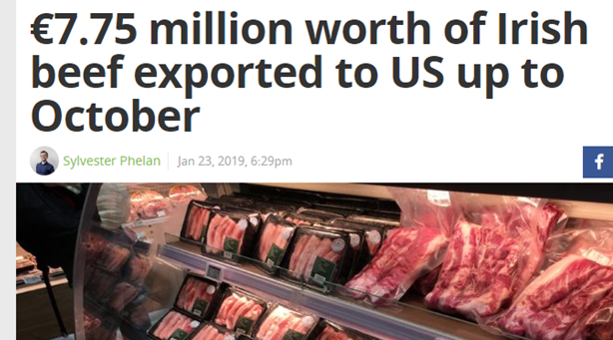
Meat quality – why?
>600,000 tonnes of beef produced in 2018 (Bord Bia)
Exports €2.5bn
5th biggest exporter in the world

Slide 3
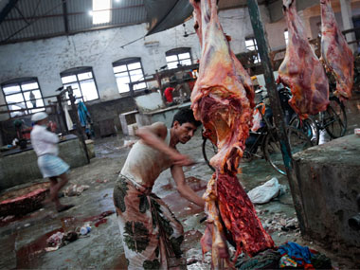
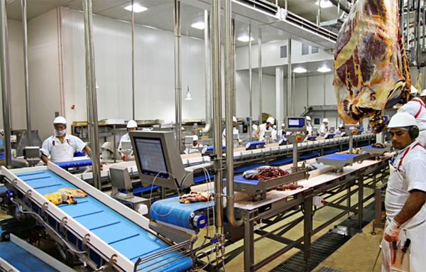
Can we breed for it?
Huge improvements in meat quality in recent years..
Where will the next jump in quality come from?

Slide 4
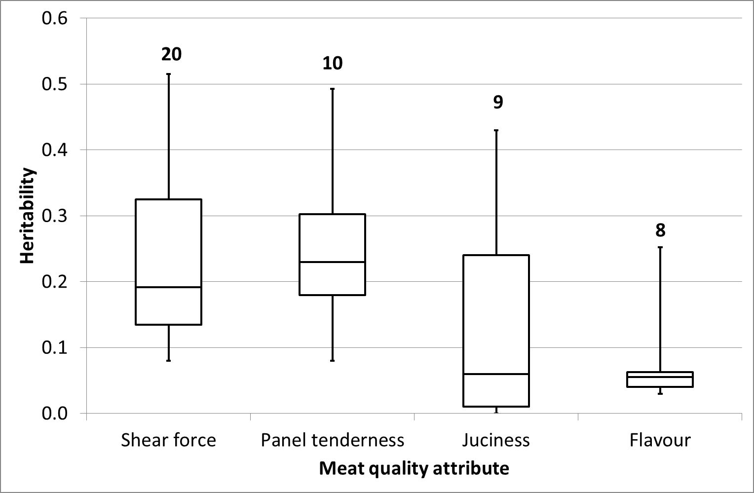
How much is genetics?
Highest 25% of estimates
25% to 50% of the estimates
Middle estimate
Lowest 25% of estimates

Slide 5
Genetic Evaluations
A way to rank animals based on their (and/or their family members) performance for a certain trait(s)
What?
Weight of retail cuts, pedigree information & other info
How?
Estimated breeding values (EBVs) for all animals
&
Reliability figure – level of confidence

Slide 6
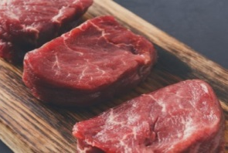
The Data
Currently >5,000 cattle slaughtered
Range of phenotypes collected including sensory analysis of meat
Trained panellists
Tenderness
Juiciness
Flavour
1
10

Slide 7
How much is genetics?
$${\text{h}}^{\text{2}} \text{=} \frac{\text{Genetic} \text{var}iance}{\text{Phenotypic} \text{variance}}$$
 | h² (SE) | Genetic SD
Tenderness | 0.15 (0.04) | 0.16
Juiciness | 0.11 (0.06) | 0.17
Flavour | 0.12 (0.04) | 0.14

Slide 8
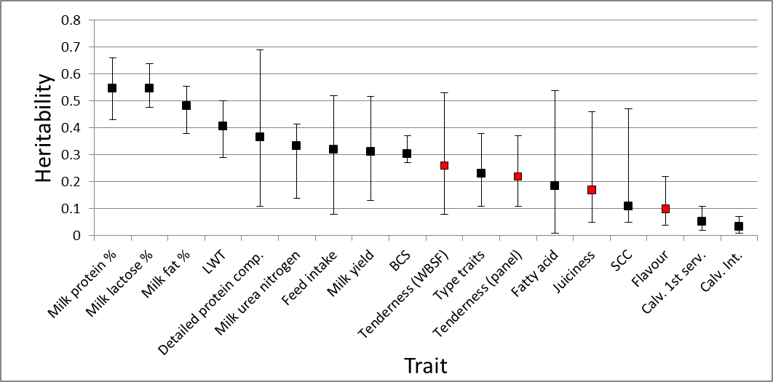
How much is genetics?

Slide 9
How much is genetics?
$${\text{h}}^{\text{2}} \text{=} \frac{\text{Genetic} \text{var}iance}{\text{Phenotypic} \text{variance}}$$
 | h² (SE) | Genetic SD
Tenderness | 0.15 (0.04) | 0.16
Juiciness | 0.11 (0.06) | 0.17
Flavour | 0.12 (0.04) | 0.14

Slide 10
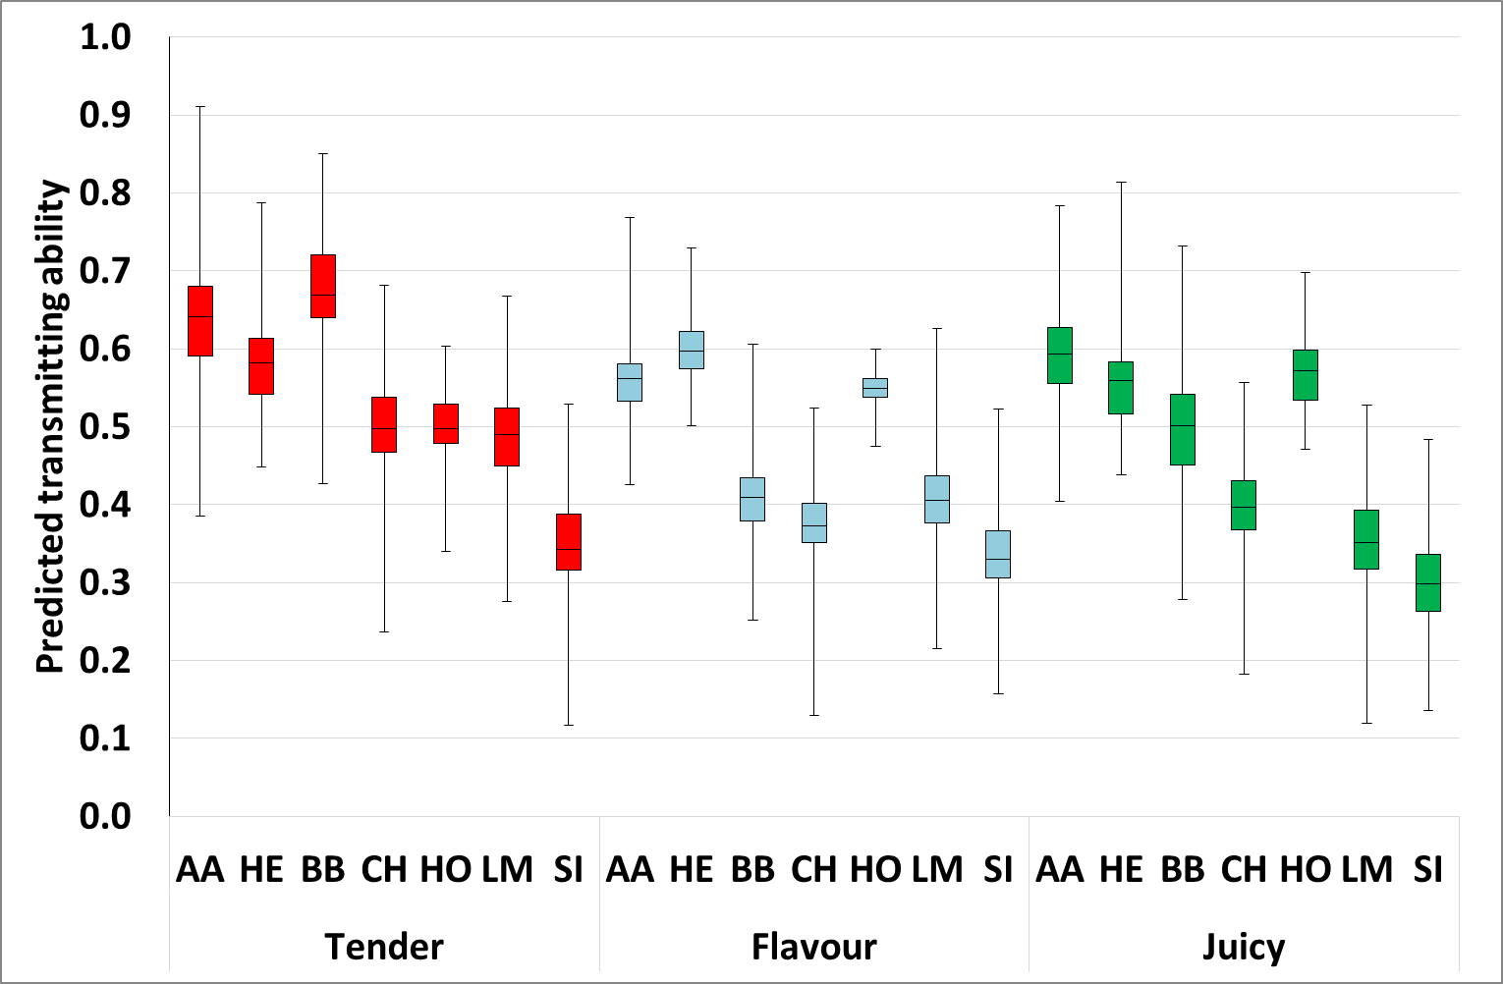
Within breed differences
25% of Simmental sires are better than worse angus

Slide 11
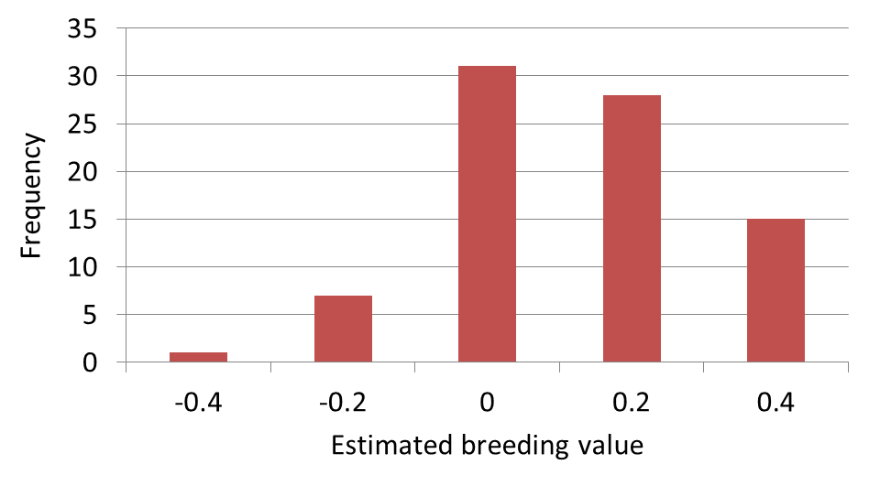
Genetic evaluations
EBVs of sires with reliability of ≥30%
Progeny undergoing consumer trial

Slide 12
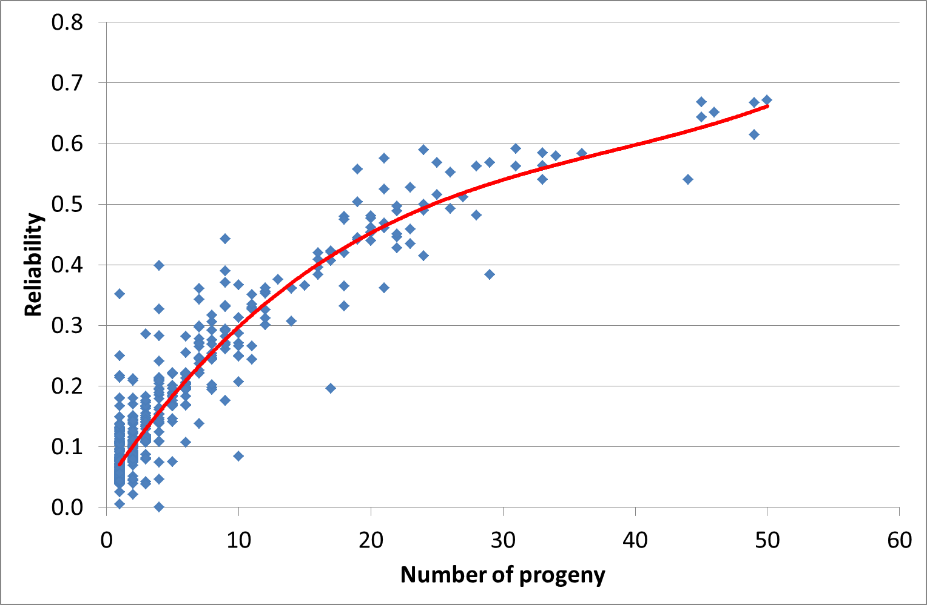
Importance of data

Slide 13
Terminal Index
Made up of the traits that are important to farmers that breed cattle for slaughter
Meat Quality?
Terminal Index
Trait | Emphasis | Economic Value (€/unit)
Calving Difficulty | 18% | -4.65
Gestation | 4% | -2.25
Mortality | 4% | -5.34
Docility | 2% | 18.92
Feed intake | 16% | -0.13
Carcass weight | 41% | 4.03
Carcass conformation | 11% | 18.93
Carcass fat | 5% | -10.08

Slide 14
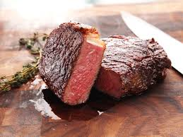
What is the terminal index currently doing to MEQ traits?
The changes in the eating quality traits per generation:
Tenderness will increase by 0.07 units
Juiciness will remain constant
Flavour will decrease by 0.03 units

Slide 15
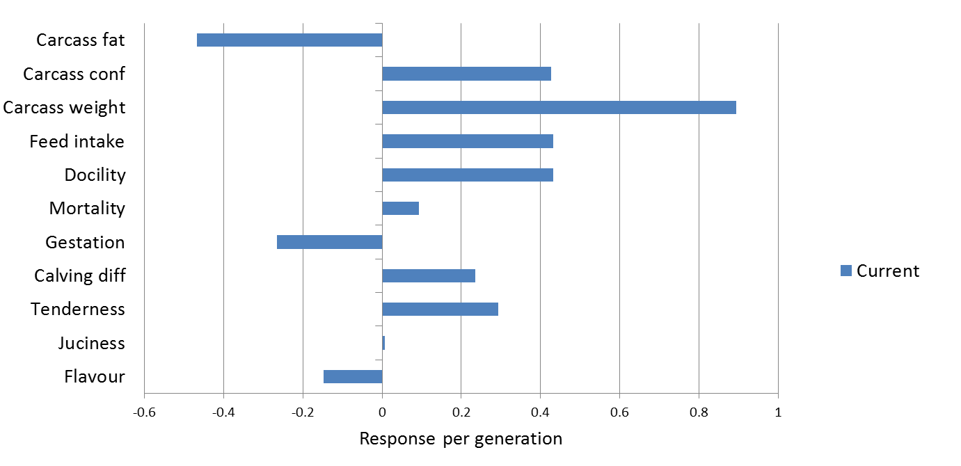
Selecting for MEQ traits

Slide 16
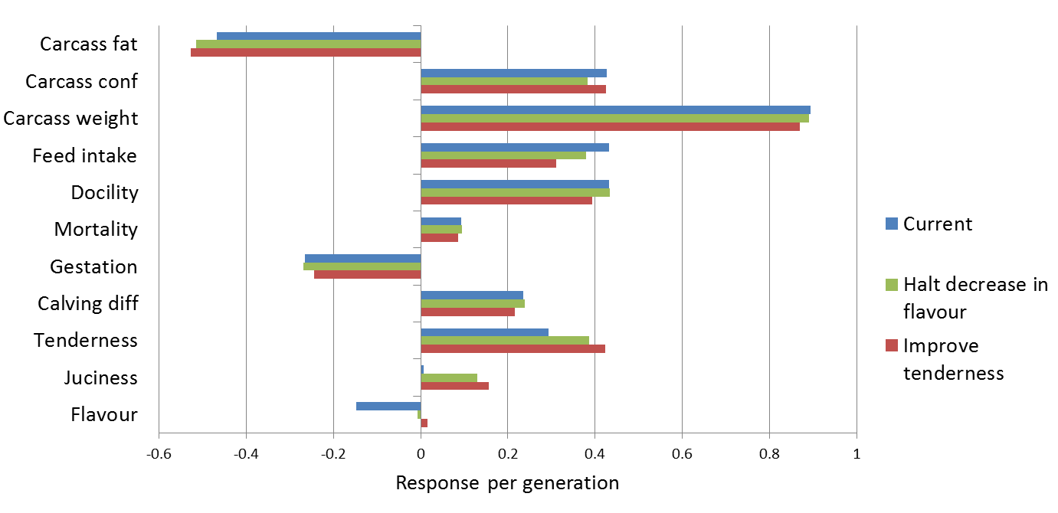
Selecting for MEQ traits

Slide 17
Take home messages
If factory process is streamlined breeding could bring a massive improvement to meat eating quality
Ireland will launch meat quality EBVs for AI sires with the hope of identifying superior sires

Slide 18
Future work
Work on-going to incorporate GENOMICS to meat eating quality index index
19% reliability → 37% reliability

Slide 19
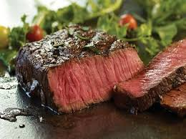
Thank you for your attention
Any questions?

